Slide 1
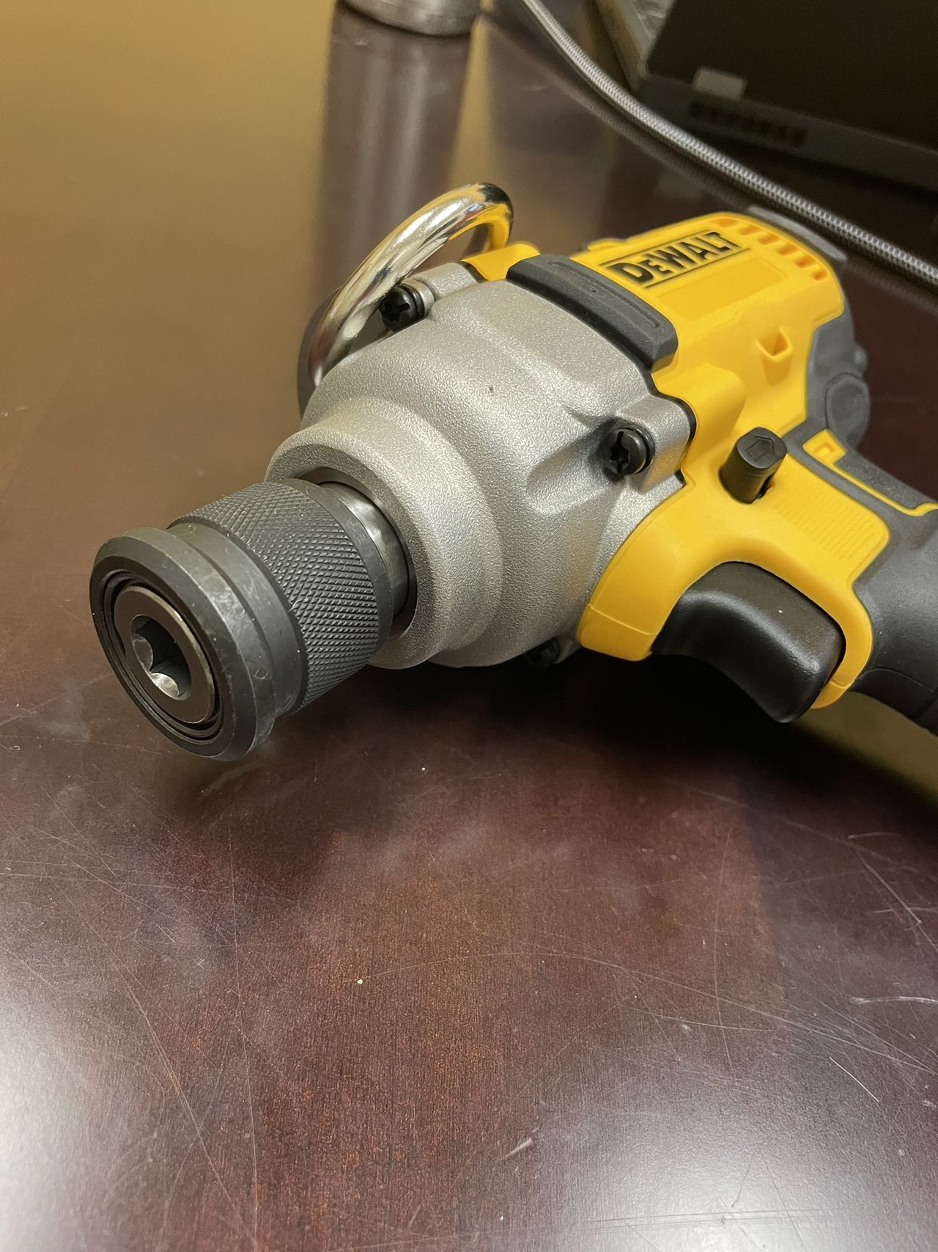
23 yrs
A Professional Power Tool Core Components Manufacturer
Precision Machined Parts • Forging • Assemblies
Custom Engineered Solutions

Slide 2
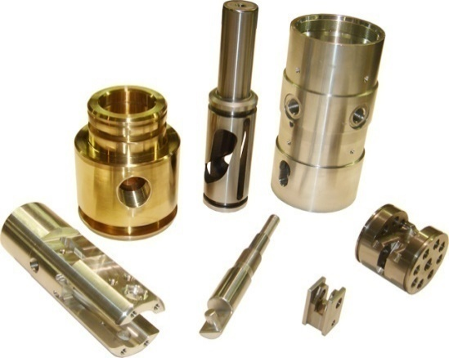
BUSINESS OVERVIEW
FORTIS MANUFACTURING SOLUTIONS
Precision Machined Parts
Assembly
Gear Box & Sub-assy
Custom Engineered Solutions

Slide 3
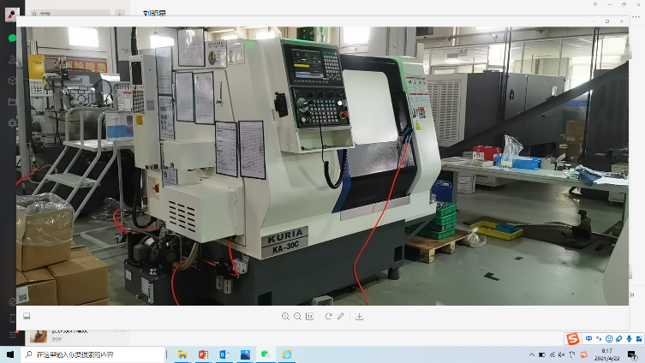
UNIQUE SELLING PROPOSITION
Full-service Supplier
Superior Quality
ISO 9001:2015 & IATF16949:2016
Emphasis on repeatability & reproducibility; 6-Sigma tools
Global Footprint
Operations in China & Mexico, US HQ
Flexible & adaptable plant layout in response to customer needs
LCP for parts & assemblies
Supply Chain Management
Experience in global logistics support
Continuous supplier development
Kan-ban systems
24/7 operation
Other Process
13 years of cold forge process
experience
18 years of investment casting
process experience
10 years of powder metallurgy
process experience
Long-Term Customer Focus
Cost-down Solutions
VE/VA capability
Mfg. engineering support

Slide 4
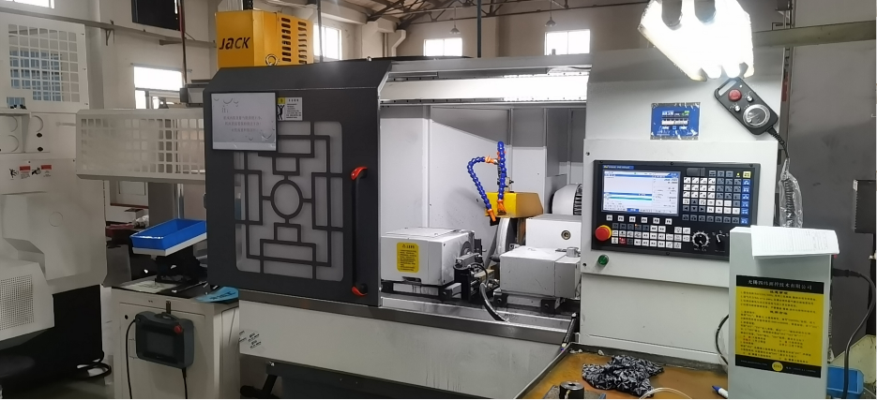
CAPABILITIES
Precision Assembly
Advance Quality & Process Plan
Design & build assembly cells
Pockets of Automation
Full Automation
Mistake-proofing
Precision Parts Machining
Multi-axis CNC Turning
Milling and Hard Turning
High Speed Machining Centers
Grinding and Shot-peening
Lapping, Polishing, Honing
Ultrasonic Cleaning
Multi-axis Swiss machining
Custom Engineered Solutions
New Product Design, Feasibility, and Development
Mistake-proofed & Computerized Assembly Cell Design and Build
Prototype and Proof-of-concept
Fixture Design and Build
Leak Test Design and Build
Impactor Tool Gearbox Durability Test Design and Build

Slide 5
GLOBAL FORTIS GROUP FOOTPRINT
Nantong
Suzhou
WuJiang
PA, USA
Ningbo
Mexico

Slide 6
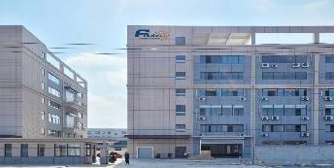
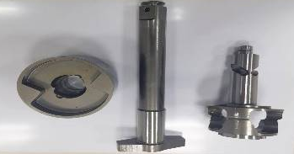
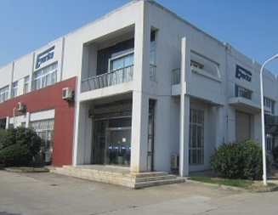
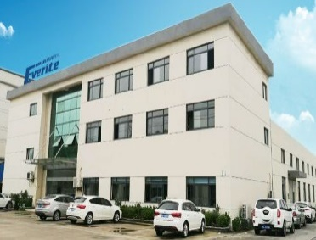
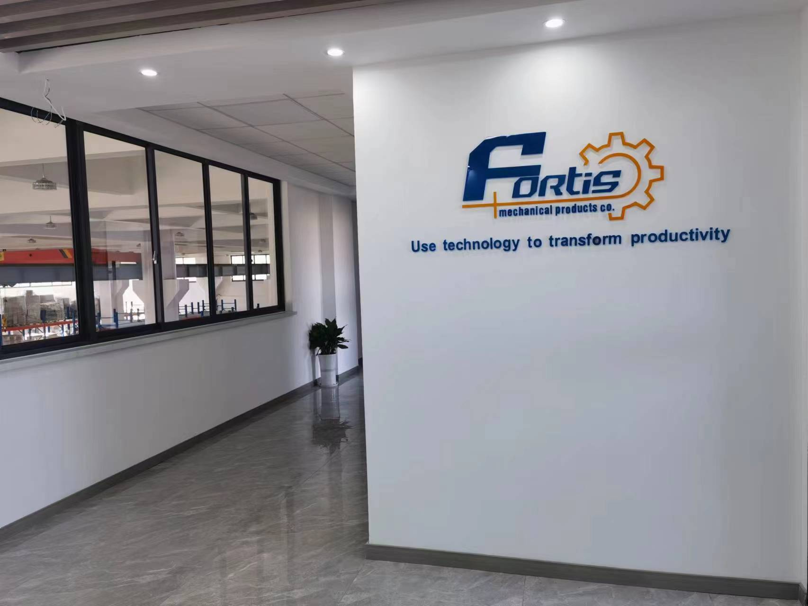
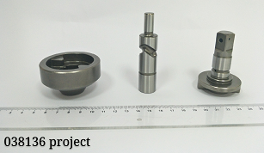
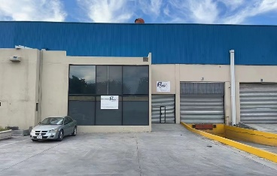
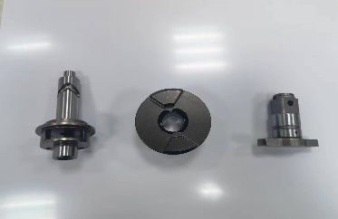
Our Development History
2022
2010
2014
2019
Establish New Factory in Ningbo 2022
2000
2012
2016
Establish Wujiang Factory in April 2014
Develop Special Material for Hammer, Cam shaft and Anvil
Establish Suzhou
SIP in 2010
Develop 3000Nm Impact
Development Hammer, Cam shaft and Anvil Process In USA and China
Develop Cold forging process for Hammer, Cam shaft and Anvil
Supply Automobile parts to Sango
Establish New Factory in Nantong 2022
Develop 800Nm Impact for DeWalt
Supply Hammer, Cam shaft and Anvil to Milwaukee
Develop Hot forging process for Hammer, Cam shaft and Anvil
Establish Mexico Factory in April 2021
Supply Automobile parts to BorgWarner
Develop 1500Nm Impact
2013
2018
2015
2021

Slide 7
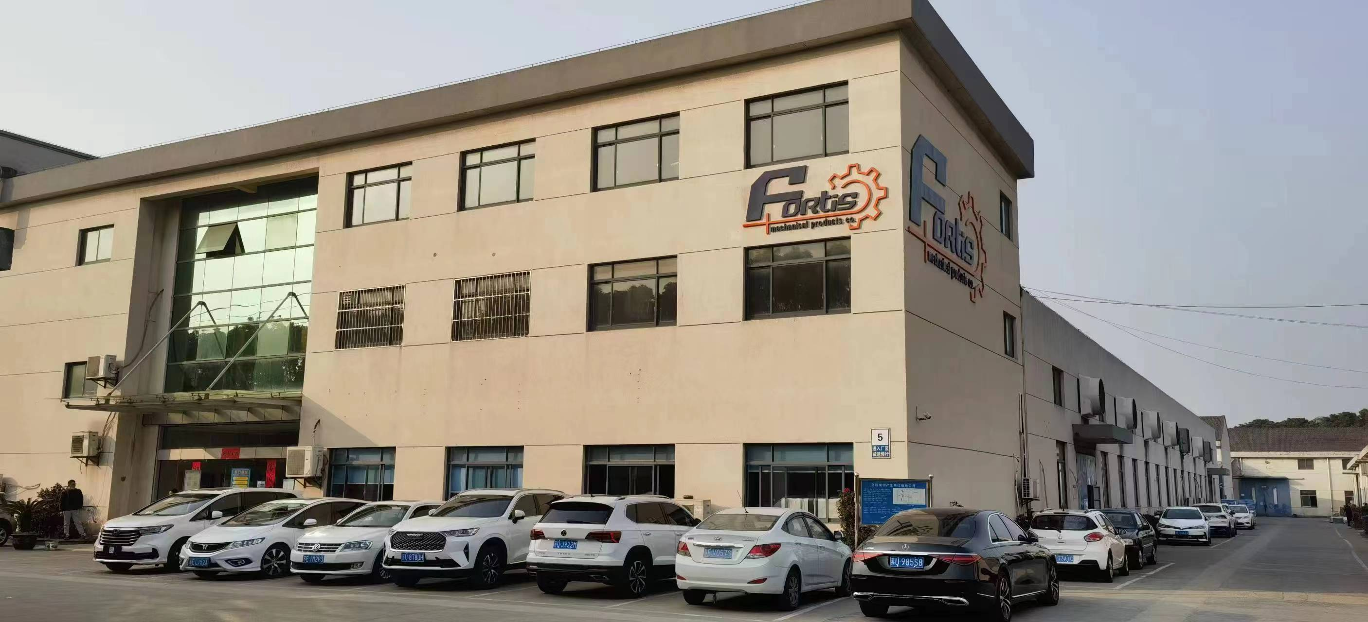
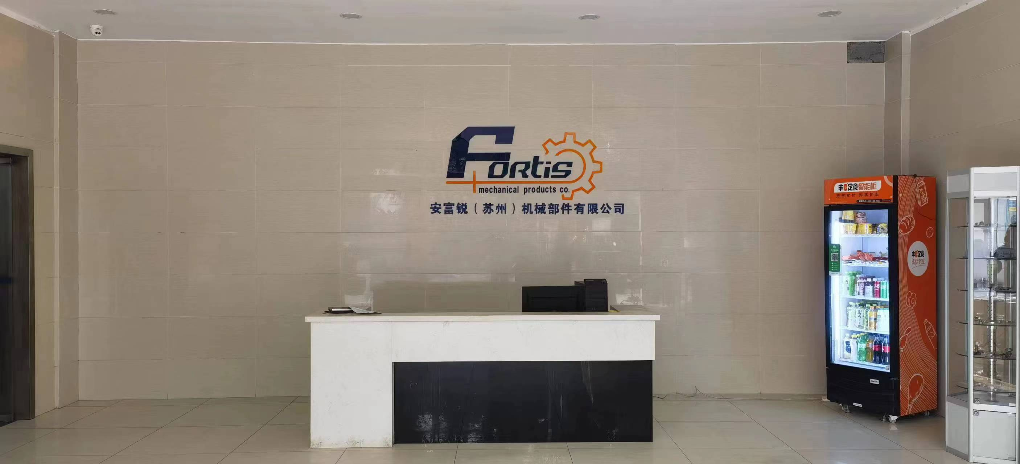
FORTIS Group OPERATIONS
Since 1950, FORTIS products and services have been solving difficult manufacturing problems. The intention of FORTIS was, and still is, to be an innovative full-service company that addresses the complex and precise manufacturing requirements.
Extensive experience in manufacturing
and manufacturing Technology.
Flexibility and multidisciplinary
teamwork. So far, FORTIS Group
employs around 420 Associates.
Ingenuity and willingness to go beyond
customer expectations.

Slide 8
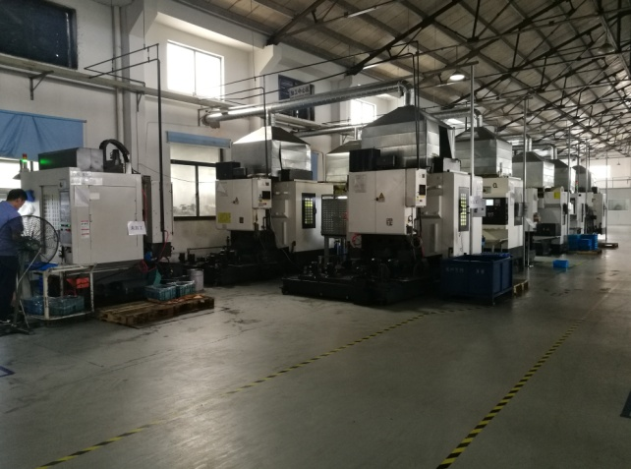
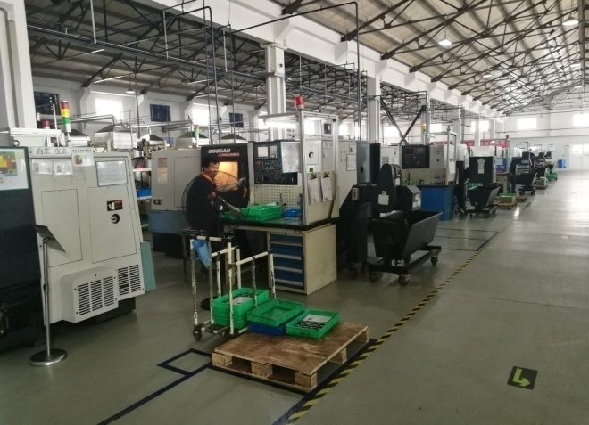
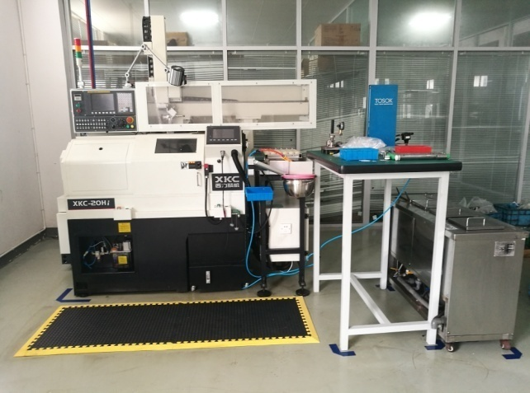
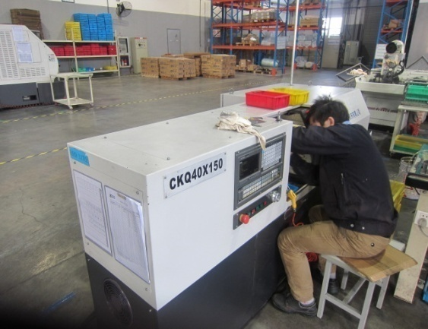
FORTIS Group - WUJIANG
Precision Machining Operation

Slide 9
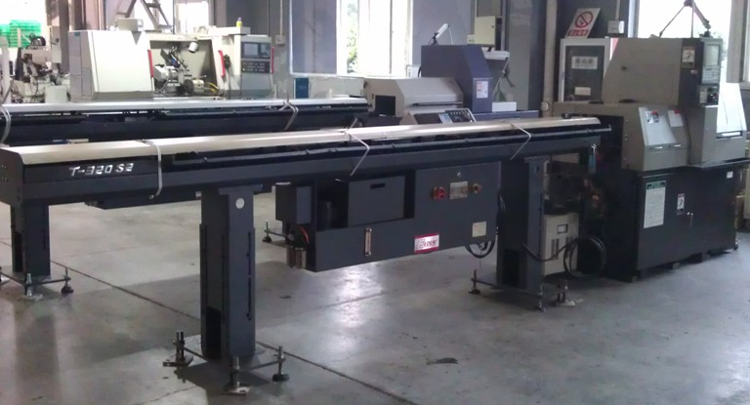
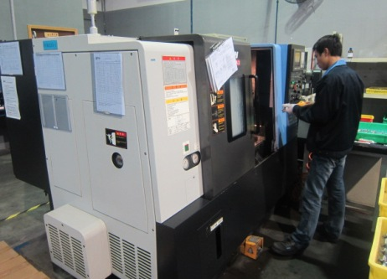
FORTIS Group - WUJIANG
Precision Machining Operation

Slide 10
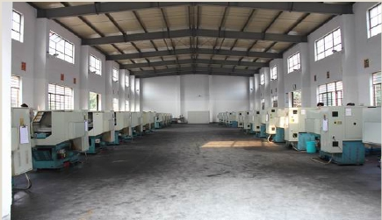
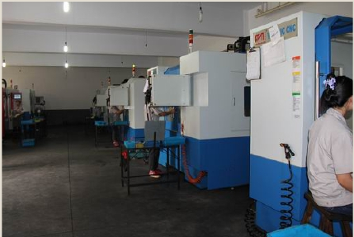
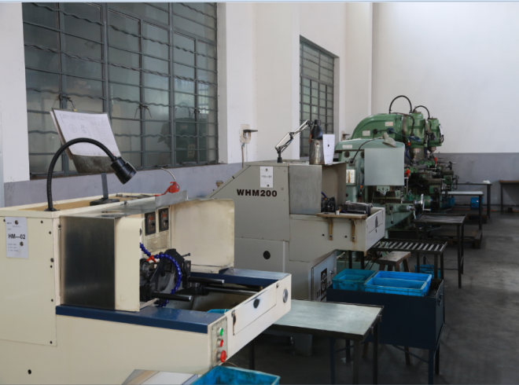
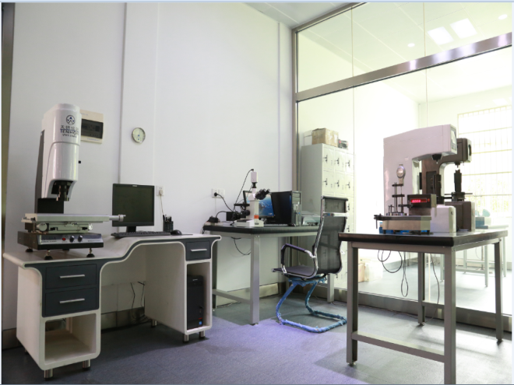
FORTIS Group - Ningbo
Precision Machining Operation

Slide 11
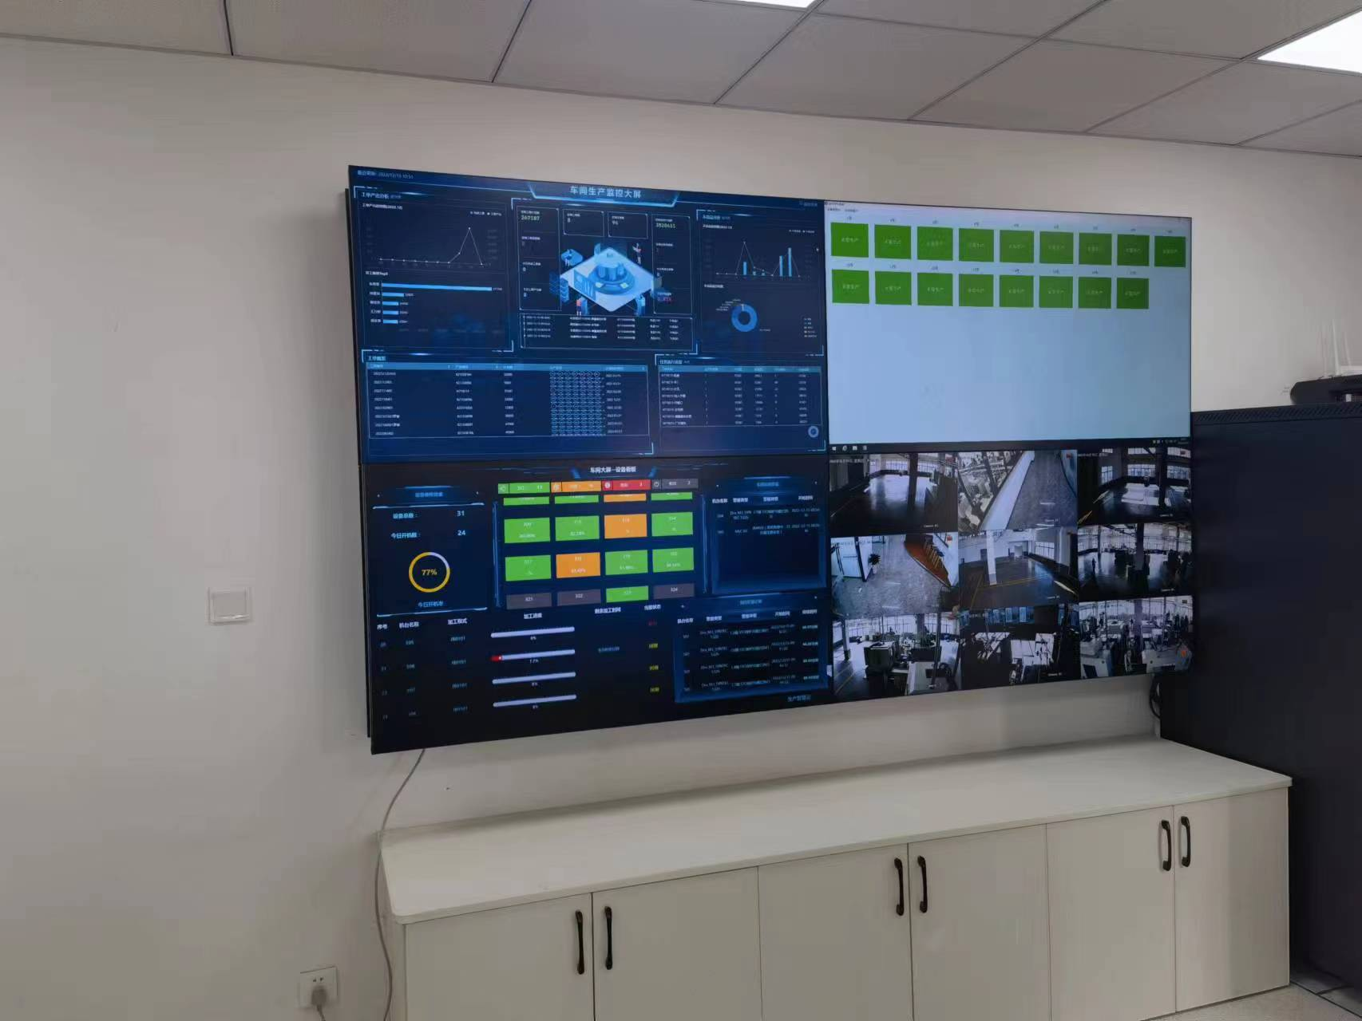
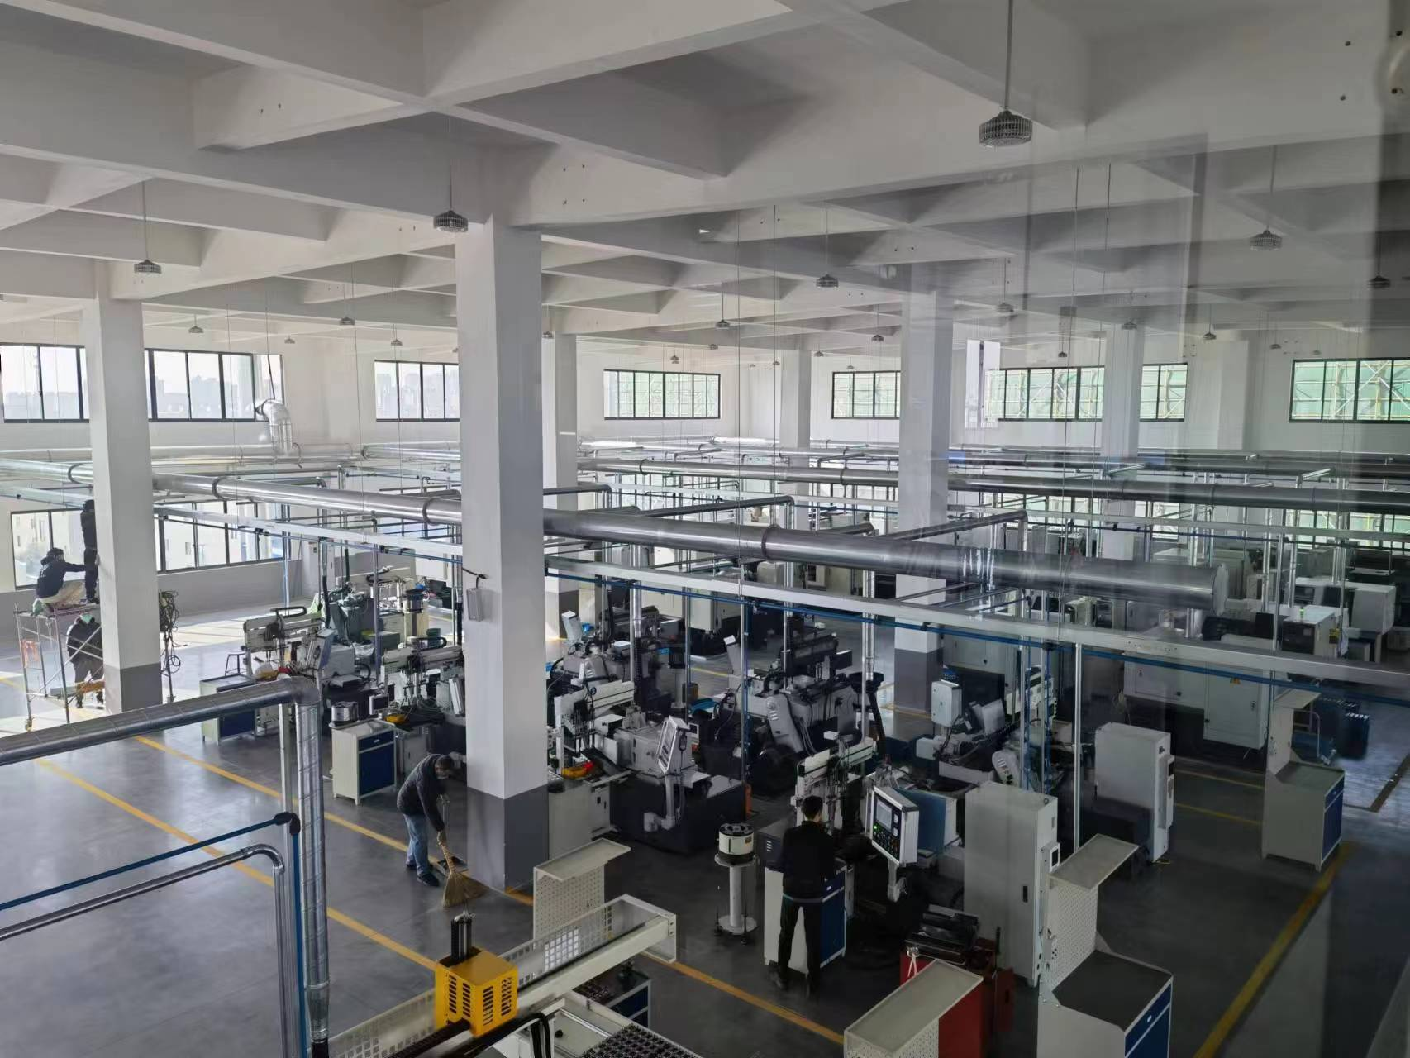
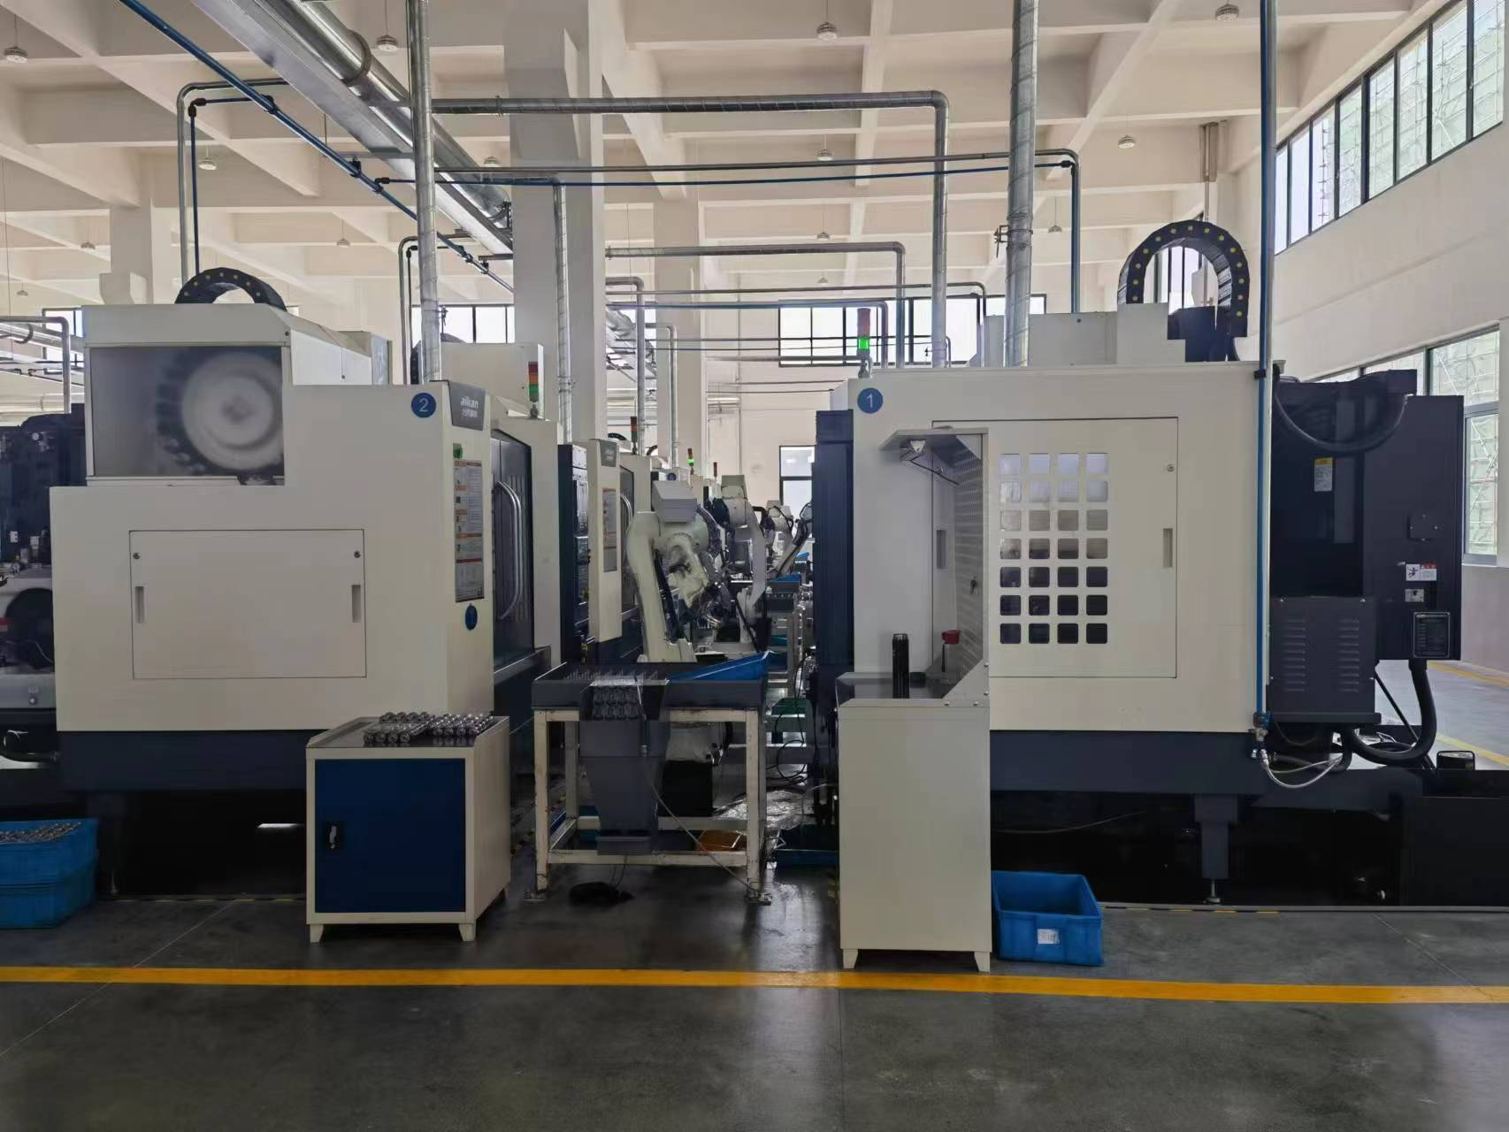
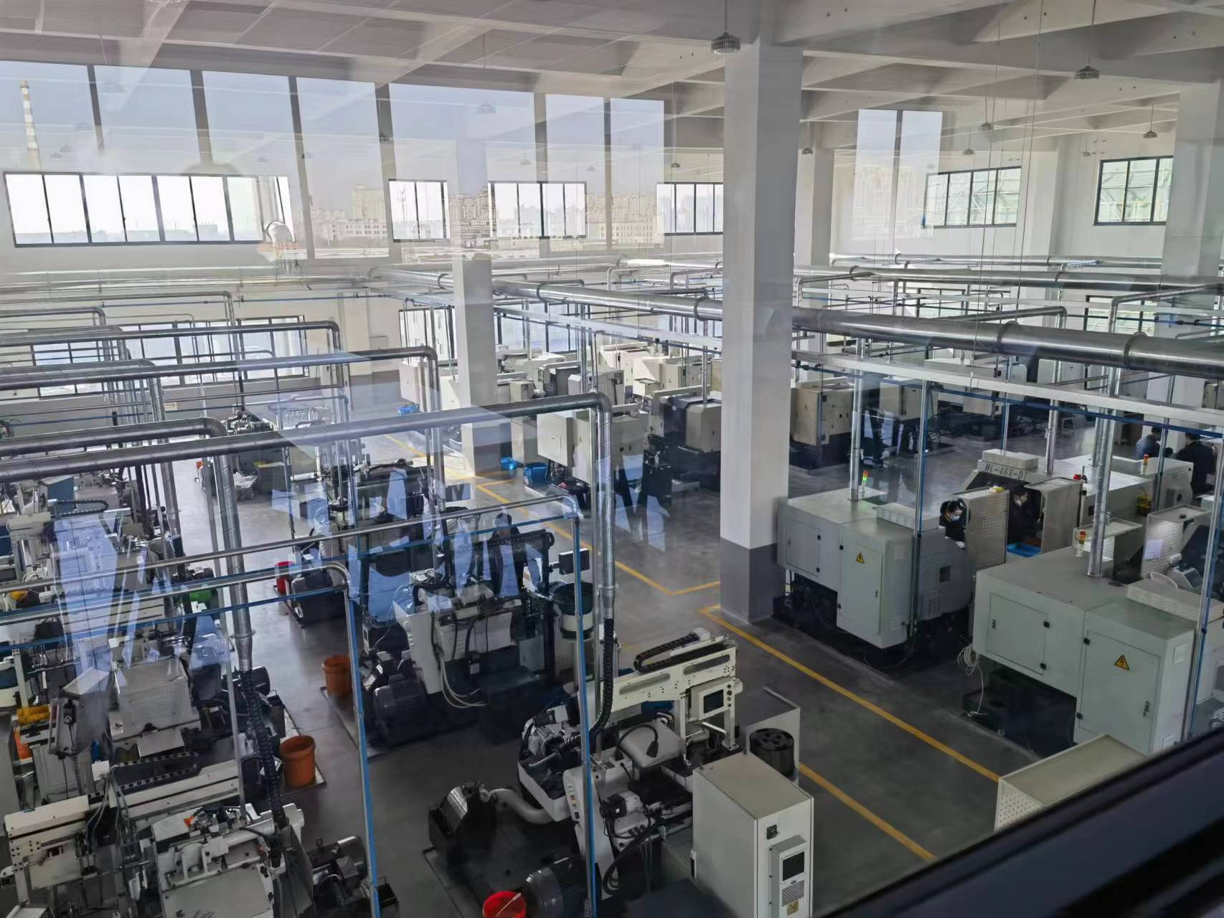
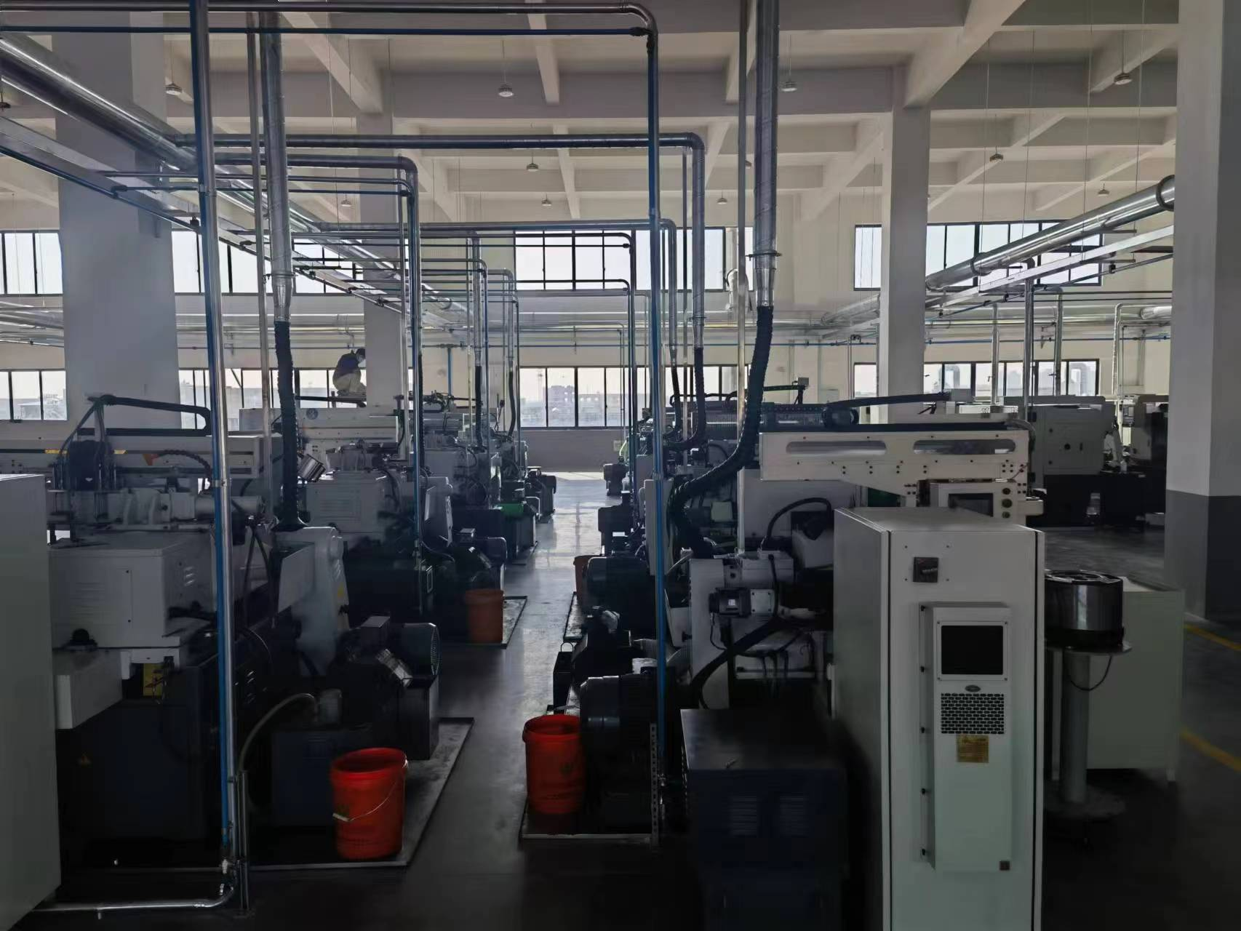
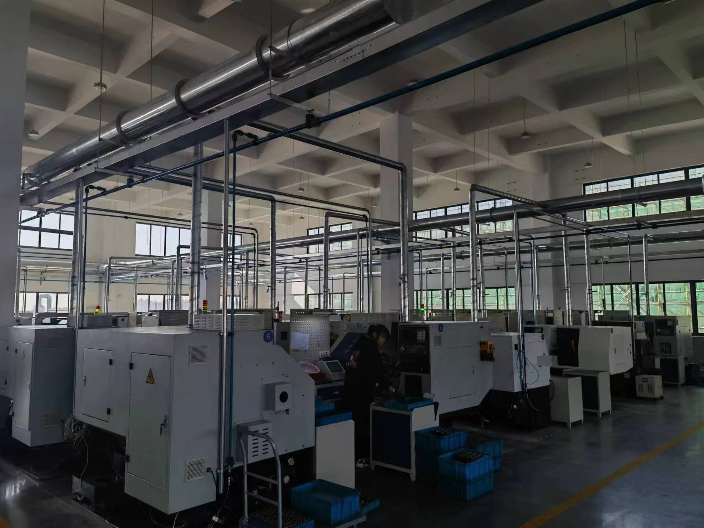
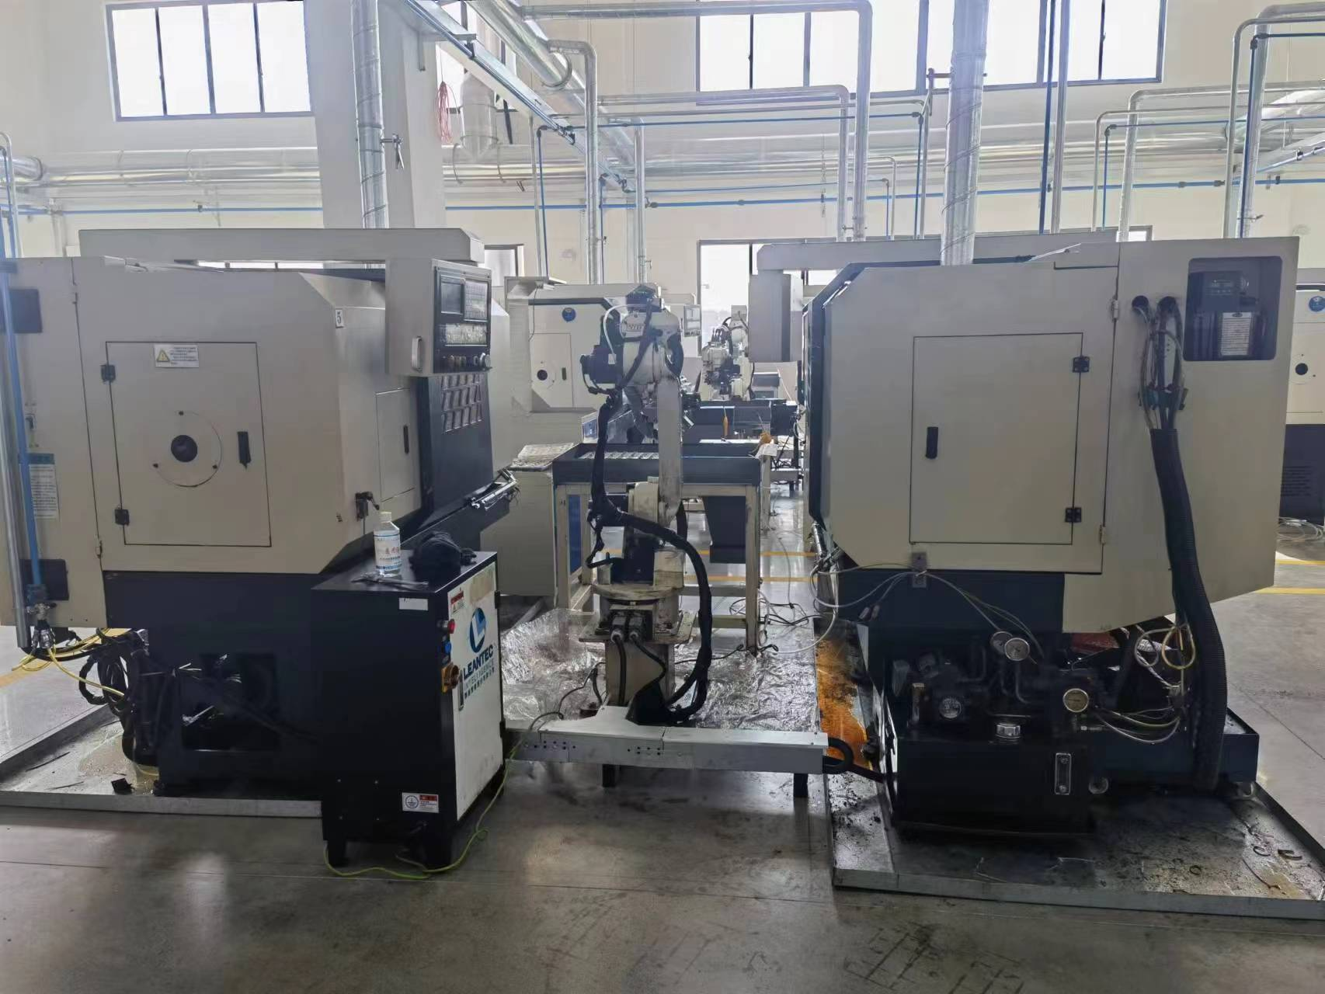
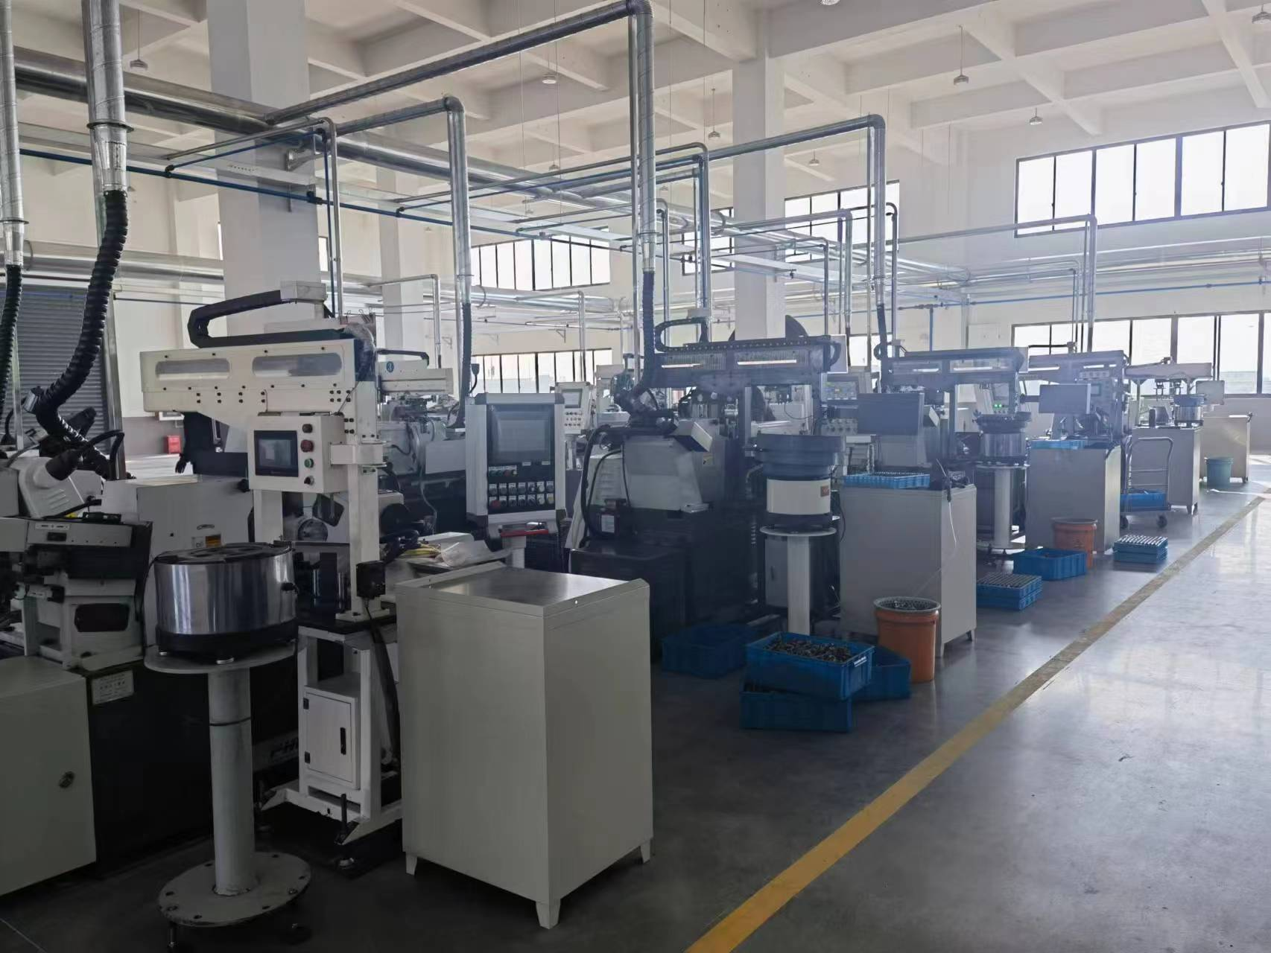
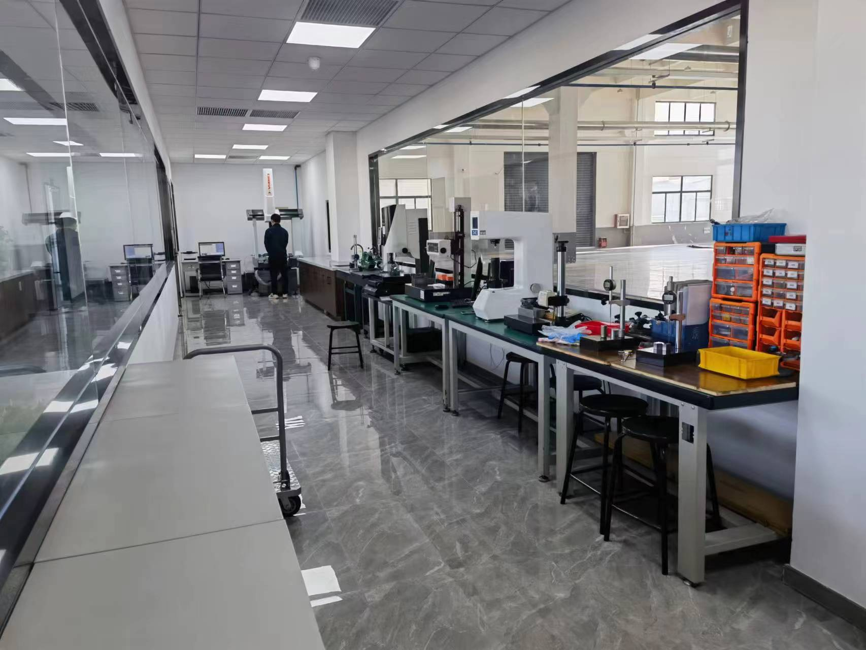
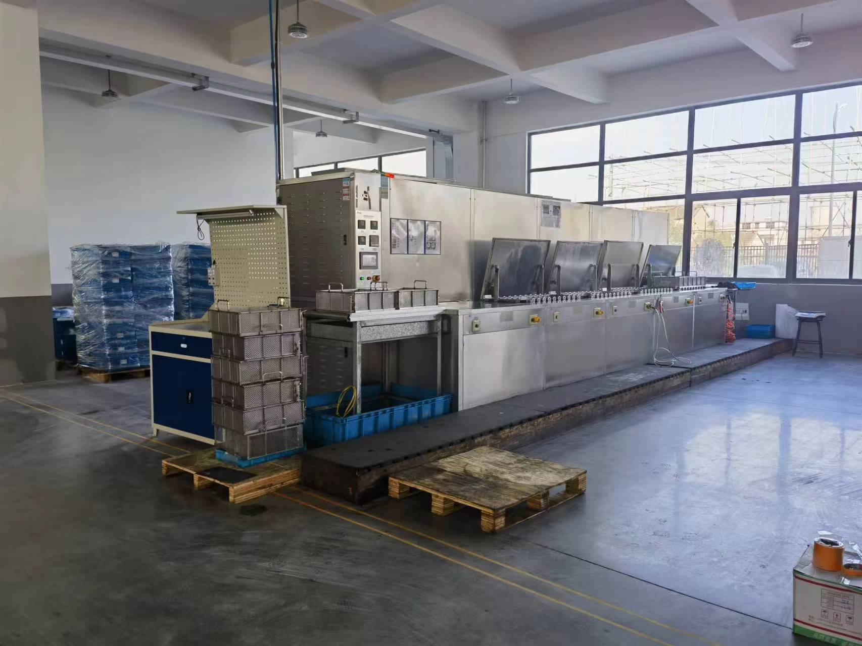
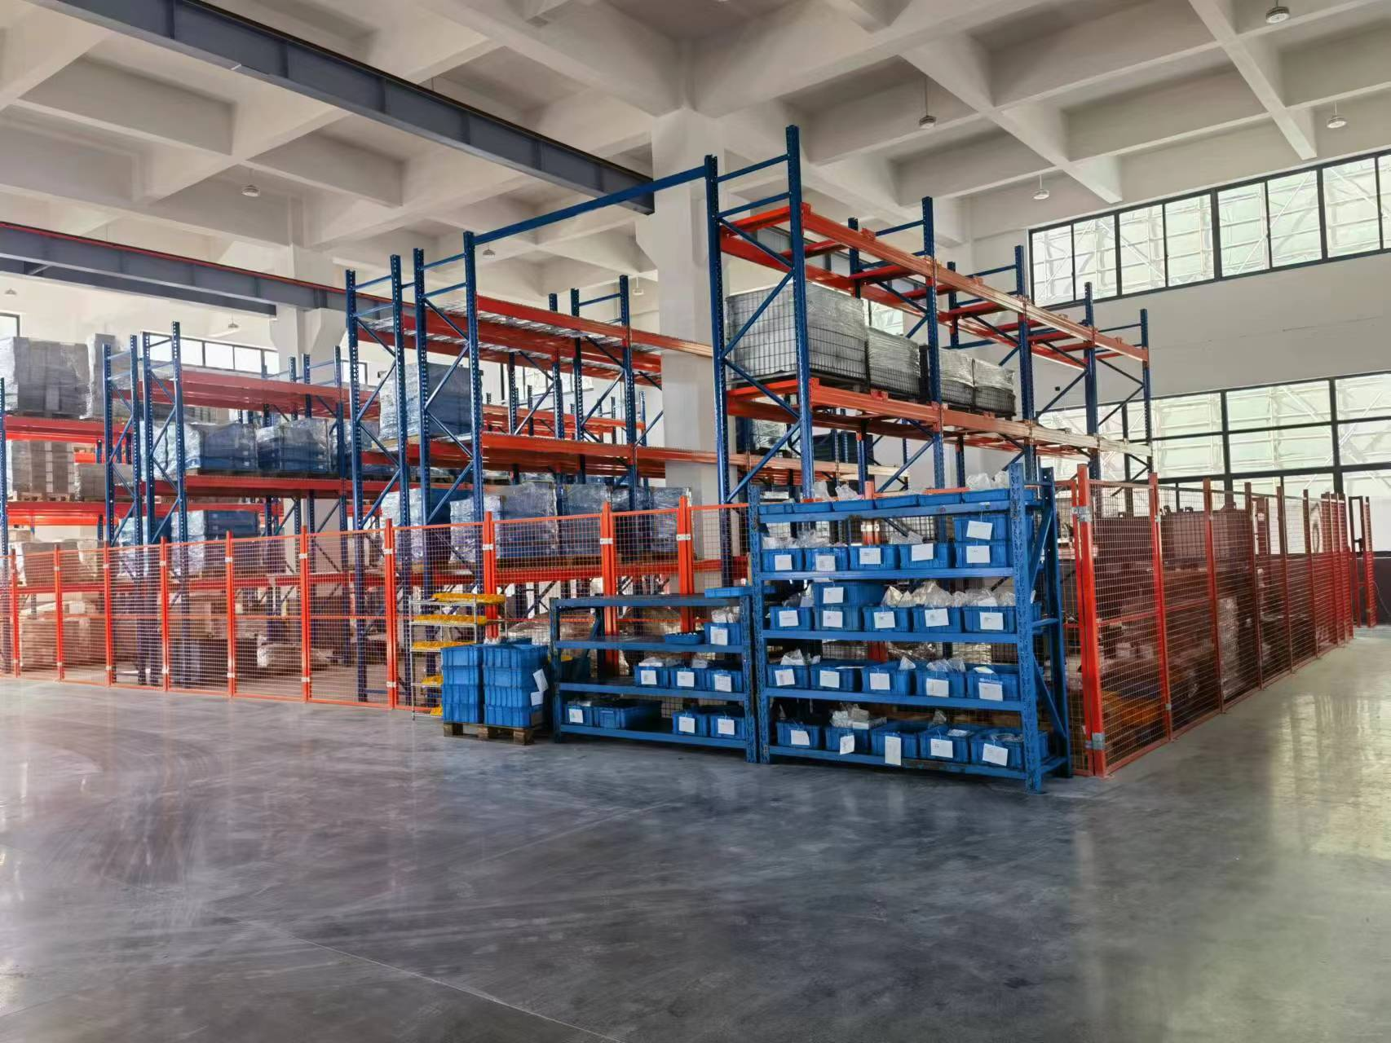
FORTIS Group - Nantong

Slide 12
23 yrs
Agreement signed by SB&D and Fortis Group on June 11, 2021
TO ESTABLISH A NORTH AMERICAN
MANUFACTURING FOR COLD FORGING, MACHINING, & ASSEMBLY

Slide 13
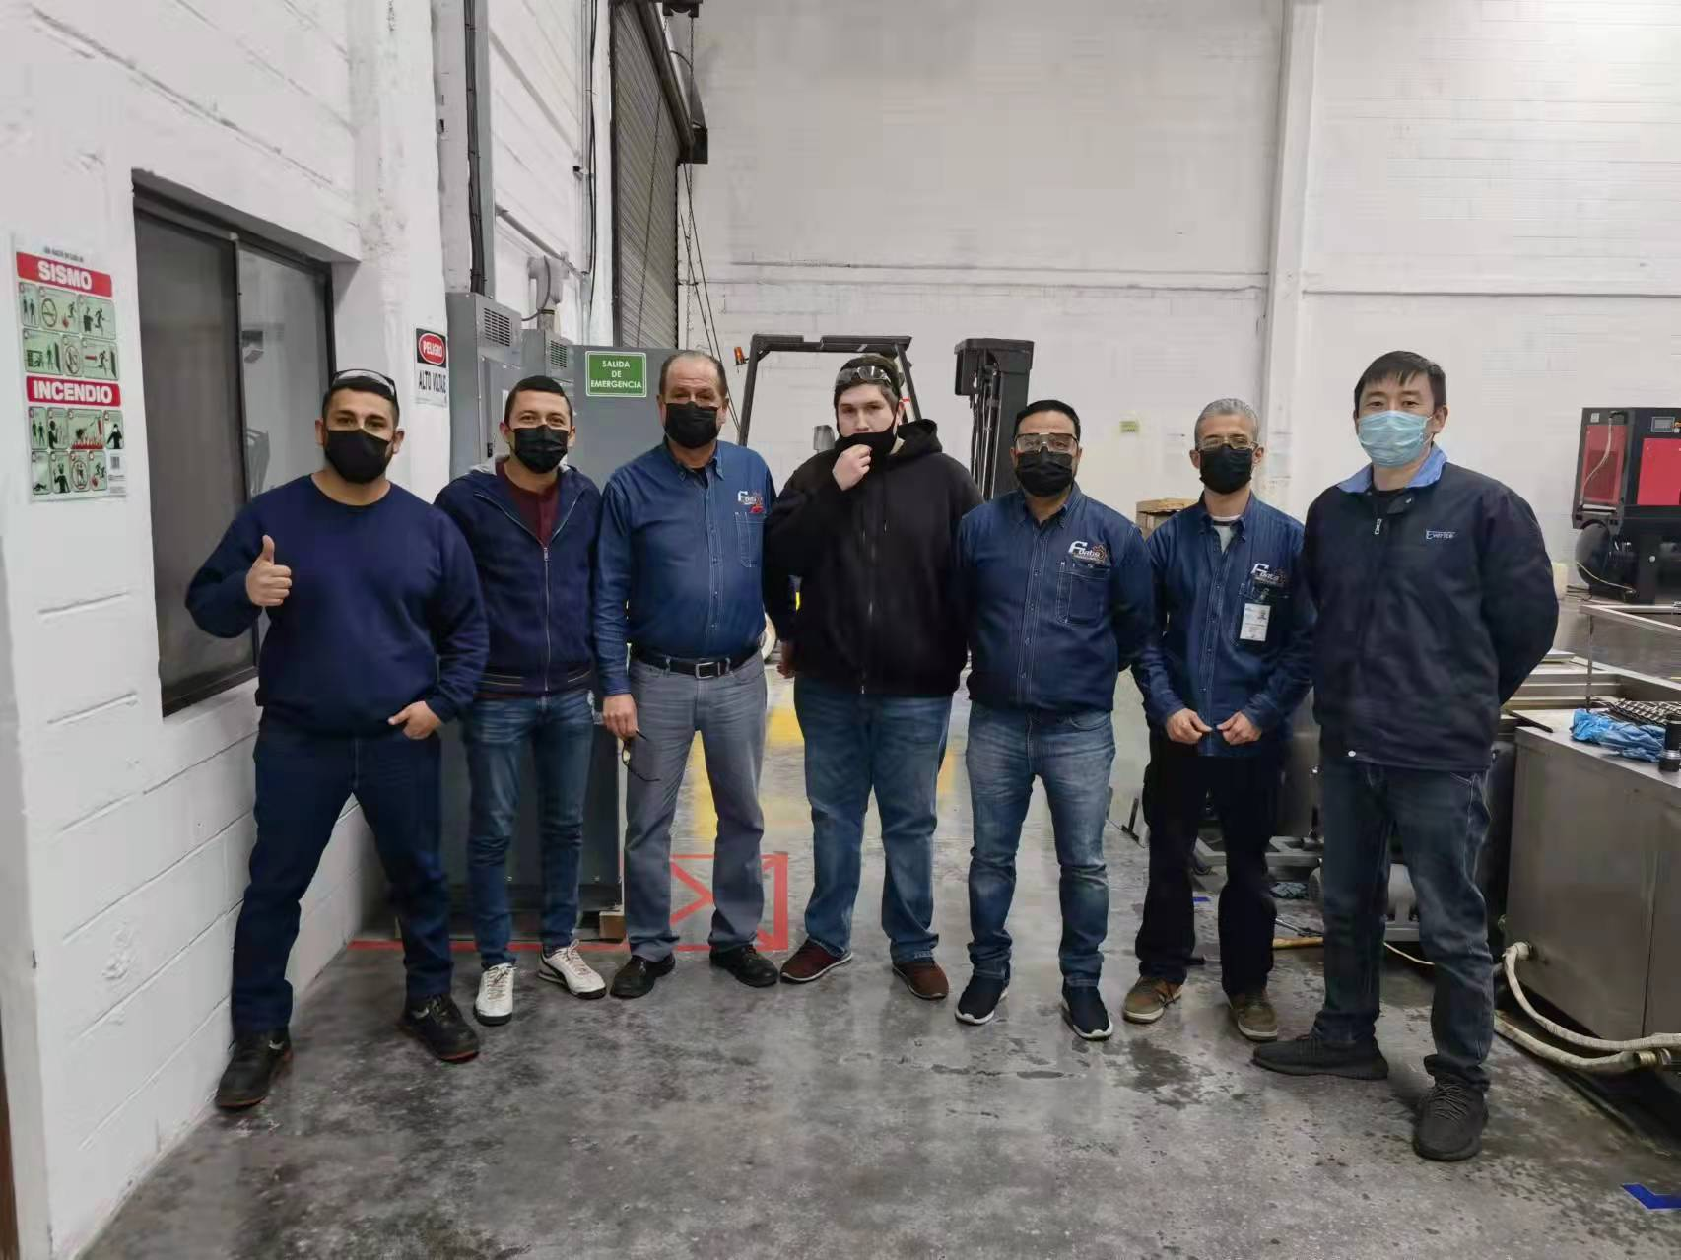
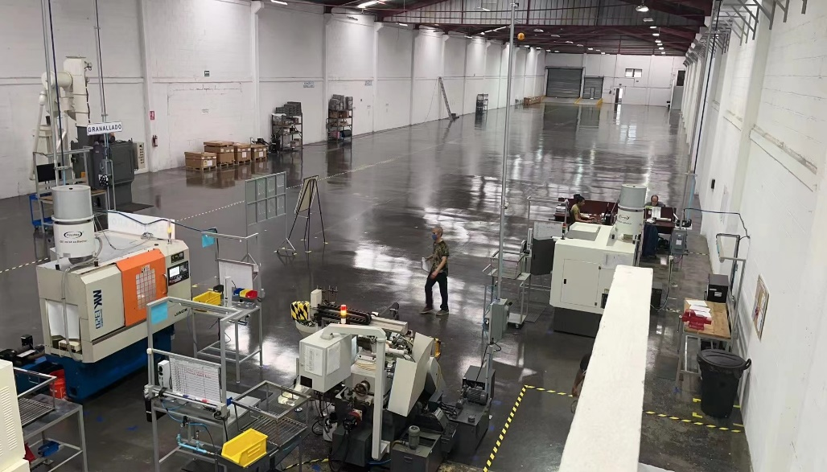
FORTIS Group - Fortis Technologies Monterrey, Mexico
Started Investment on New Factory in Monterrey, Mexico in November 2021.
Factory Area: 24,000 Sq. Ft. (expansion planned)
Teamwork. So far, we employ 11 people
Precision CNC Machining
New factory and High Precision Equipment for SBD and Other potential Customer
Production started in September 2022
FORTIS Group- Fortis Technologies

Slide 14
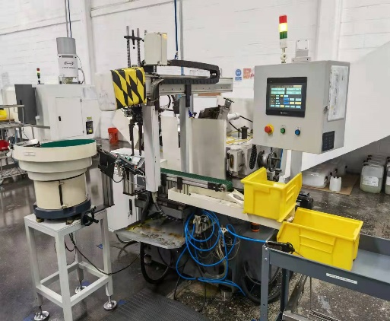
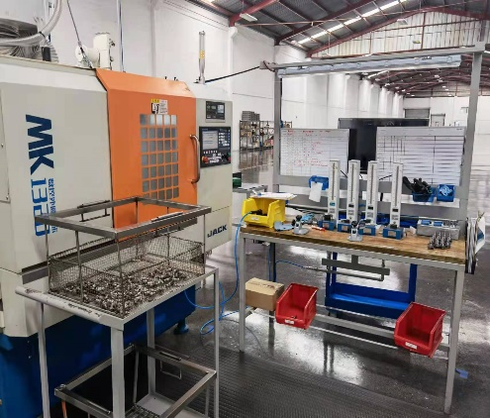
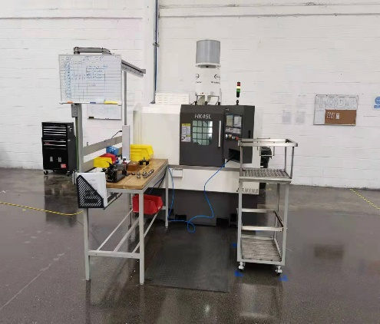
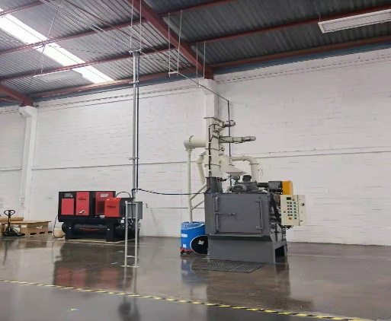
FORTIS Group - Fortis Technologies Monterrey, Mexico
Fortis Layout
Precision Machining Operation
14
Notes:
14

Slide 15
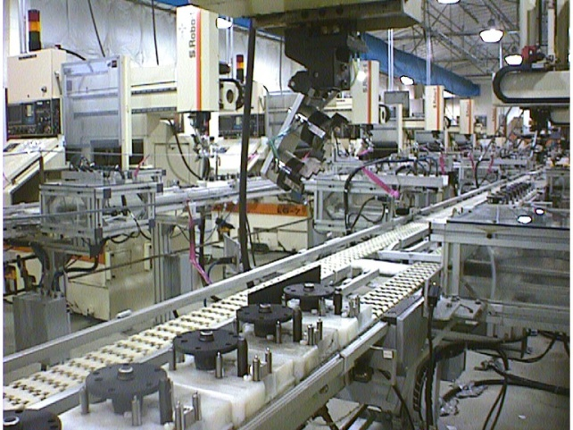
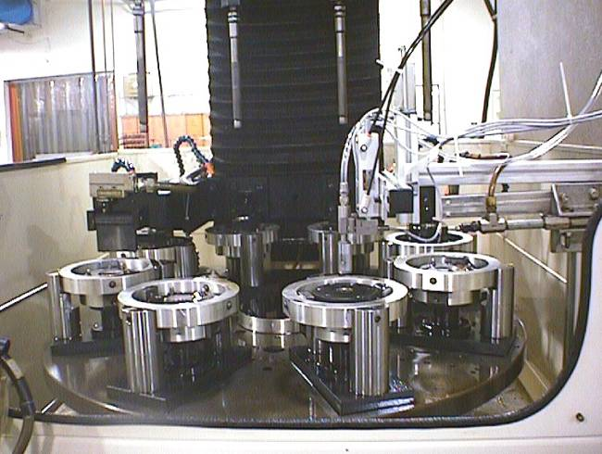
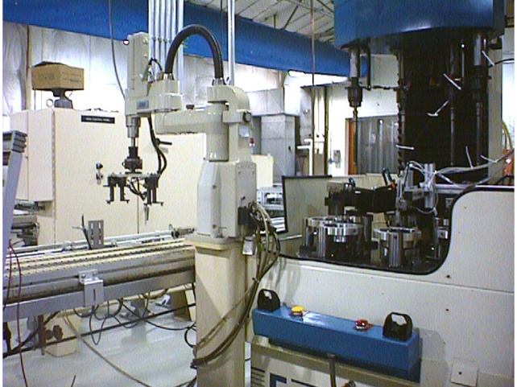
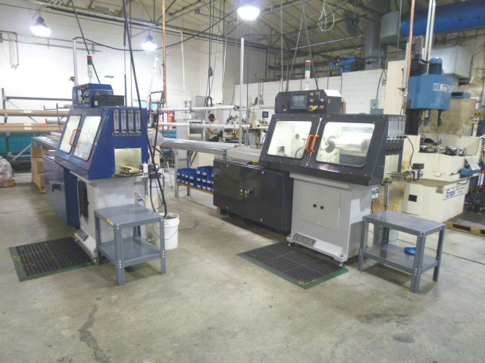
FLEXIBLE PLANT LAYOUT
Fedders Production Line
Indexing Station for Honing
Pick & Place
Burr-free Cutting
Gear Box Assembly Line
Gear Box Assembly Line
15
Notes:
15

Slide 16
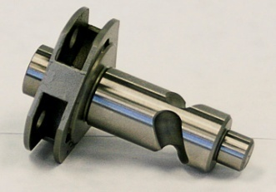
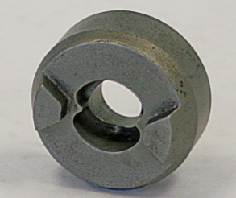
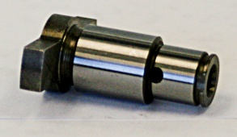
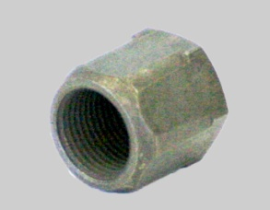
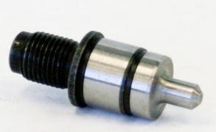
PRECISION MACHINED PARTS: EXAMPLES
Cam Carrier: 1100k/yr.
Small Impactor: 1100k/yr.
¼ Hex Anvil: 1100k/year
Collet Nut: 225k/yr.
Output Spindle: 4210k/year
Gear Box: 40k/year
Wobble Arm: 105k/year
Manifold: 25k/year
Clevis Pin: 300k/year
Magazine Interface: 60/year
Channel Yoke: 500k/year
Profile Cast: 60k/year
Body Machine: 400k/year
1/8 Collet: 225k/yr.
Compressor Flange: 50k/year
Armature: 400k/year
16
Notes:
16

Slide 17
Other Parts For Power Tools : EXAMPLES
Nut: 300k/yr.
Screw Gun: 200k/yr.
Wobble Arm: 105k/year
1/8 Collet: 225k/yr.
Cam Plate: 3000k/year
Sleeve: 500k/year
Out put shaft: 200k/year
Gear: 3000k/year
Shaft: 3000k/year
Anvil：300k/year
Clevis Pin: 300k/year
Motor Pinion: 300k/year
Plate: 300k/year
Shaft : 200k/year
Spindle: 200k/year
17
Notes:
17

Slide 18
Exhaust Manifold Sensor Boss And GPF Boss
Powder metallurgy Process (Material : SUS434 HB)
Powder metallurgy Process (Material : SUS434 HB)
Powder metallurgy Process (Material : SUS409L CB)
Lost-wax coating Process (Material : SUS430)
Lost-wax coating Process (Material : SUS430)
Powder metallurgy Process (Material : SUS434 HB)
Powder metallurgy Process (Material : SUS434 HB)
Powder metallurgy Process (Material : SUS434 HB)
Powder metallurgy Process (Material : SUS434 HB)
Powder metallurgy Process (Material : SUS434 HB)
Powder metallurgy Process (Material : SUS434 HB)
investment casting
(Material : SUS430 )
investment casting
(Material : SUS430 )
Cold Forging Process (Material : SUS430 )
Cold Forging Process (Material : SUS430 )

Slide 19
QUALITY IN OPERATION
Lead Fly Series CMM
Roundness tester
Profile meter
Smart Scope (SP3020)
Vickers Hardness
Handheld XRF Spectrometer

Slide 20
“ENGINEERED” QUALITY
Responsive engineering services
Design/models/prototypes
Full process development
Employee participation in quality assurance
Quality is everyone’s responsibility
State-of-the-art production facility combined with rigid quality controls standards results in:
+ Close tolerances and fine finishes
+ Repeatable quality and low PPMs
+ Basis for developing and maintaining long-term relationships with key customers
QUALITY POLICY: “FORTIS is committed to achieving customer satisfaction by continual improvement of its manufactured products, services, and Quality Management System.”

Slide 21
CUSTOMERS & REFERENCES
Power Tools
Automotive
Other Industrial

Slide 22
FORTIS IS YOUR BEST PARTNER
Proven record on mix-volume machined parts & assemblies
Low-cost & affiliate material sources established
Full-time global supplier development team
Flexible workforce including 24/7 operation
Production facilities in China and Mexico plus (US R&D)
Global logistics & supply chain support
Manufacturing engineering capability
Experienced management team
Has available capacity now
Passed ISO 9001:2015 and IATF16949:2016 certifications

Slide 23
Thank You!

